Slide 1
Movie Recommender System using a Hybrid K-Means Clustering and Navie Bayes Classifier
Supervisor: Dr. XXX
Committee Member:
Dr. XXX
Dr. XXX

Slide 2
Abstract
Every day a new multimedia streaming platform comes into the market but not all are successful. To be a successful multimedia streaming platform in the market providing the content for as low cost as possible isn’t the only factor to be considered.
Providing the end user what to view or watch next is really important. The better the suggestions are the best the application is. This is what a recommender system does it suggests the content based on patterns of others users in system.
The pattern observation can be done based on different attributes like ratings, watch time, categories, content etc., Apart from selection of attributes it is also important to select a right approach for the finding out the suggestions. These types of suggestions are always user specific.
This proposal is to create a Movie Recommender System using a Hybrid K-Means Clustering and Navie Bayes Classifier (HKMNB). Most of the time data will be unsupervised data. But supervised classifiers are always better and efficient, this approach will merge the unsupervised classifier with supervised classifier so that the final recommendations might be more efficient.
The approach starts with collections of movies dataset and ratings dataset and once preprocessing is completed the data will be given KMeans to create the clusters and convert the data to supervised data. The supervised data is used to train the Navie Bayes model. This model is used to later to find out the patterns in the user watch history and provide the recommendations.

Slide 3
Introduction
The amount of data generated by the web is growing at a huge rate.
The very fact is that more products and services are available to end users now than ever has, not only compounded the matter but has also increased its scope and diversity.
This presents a major challenge to e-commerce because consumers cannot simply explore and compare every possible product.
Recommendation systems (RSs) are introduced to e-commerce to assist businesses tackle this challenge.
RSs help businesses gauge consumer interests and retain them by actively engaging them. The system provides recommendations supported the ratings on commodities that users have previously rated.
A RSs is efficient since in practice the system handles tens of thousands of ratings and prediction is calculated in real-time.
The more data the RS has got to work with, more accurate the predictions done by the system are.
Recommender systems are often classified supported the approach won’t to provide recommendations and therefore the technique used.

Slide 4
Introduction
MovieLens is a website which has these huge movies collection, along with the ratings collected from multiple users for each movie.
Using these datasets RSs can build to recommend the movies.
The dataset which has been collected will be processed so that it has the average rating of the individual movie along score i.e., numbers of users who has rated the movie and finally the average rating of each genre.
Processed dataset will be undergoing clustering process using KMeans clustering algorithm.
It uses recursion method to find n centroids for the given data. In this movie’s dataset 100 clusters are required since the score of the movies will be in between from 0.1 to 10.0 every time.
One the clustering is done the cluster value indicates the category of the movie. A movie might be on multiple clusters based on average genre rating and score.
K-Means generated output is used to train the Navie Bayes model.
A python webserver created using Flask package will be providing a REST API which takes input of user’s watch history and processes it using the trained Navie Bayes model to recommend the Movies.

Slide 5
Literature Review
Collaborative filtering is the better approach for movie RSs. Based on candidate user’s purchase history, the ratings of things for a target user are predicted. A collaborative filtering RS adopts the nearest neighbor approach. Neighbors are chosen based on the similarity of item ratings using collaborative filtering. [6]
Clustering models operate on the concept of splitting the sample space into clusters. These models are widely used in scalability problems while still delivering recommendations of comparable efficiency. The aim of the clustering models is to partition items into clusters in such a way that the objects will have the minimum distance between each of them. [7]
The giant success of the e-commerce ventures can be greatly attributed to recommender systems. As a result, they are used extensively in the e-commerce industry. Recommender systems are used to generate highly personalized suggestions for books at Amazon, movies at MovieLens and Netflix. They help filter out humongous masses of irrelevant information, also called noise, from the information that can be leveraged to make highly intelligent suggestions and business decisions. [8]

Slide 6
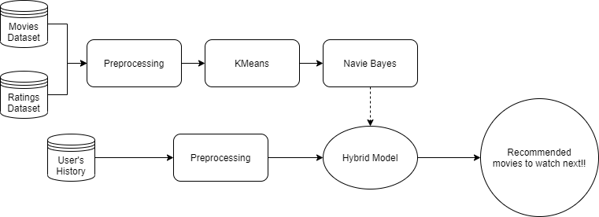
Methodology
This proposed Movie Recommender System uses a Hybrid Classifier consisting of KMeans and Navie Bayes.
KMeans is an unsupervised based clustering algorithm whereas Navie Bayes is an supervised based classification algorithm.
The both combined to form a hybrid classifier working to find out the patterns in the users movie’s watch history and recommend movies for them based on the patterns.

Slide 7
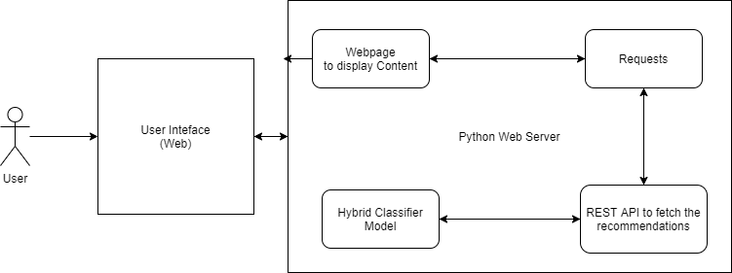
Methodology
The trained Navie Bayes model is used in the webserver to provide the movie recommendations in the real time to the users.
The webserver consists of two endpoints. One of the endpoints is root which provides a web-based interface for user to provide input and view the output.
The other endpoint is a REST API taking input as users watch history and processes it using Navie Bayes model and sends back the output.

Slide 8
Algorithm
Preprocess the dataset
Select the ‘k’ value i.e., the number of clusters you want to identify.
Choose randomly ‘k’ data points as centroids (c1, c2…, ck) from the vector space.
Repeat until convergence:
for each data point xi:
find the nearest centroid cj using Euclidian distance.
assign xi to that nearest cluster j.
for each cluster find the new centroid which is the mean of all the xi points assigned to that cluster j.
Terminate when none of the cluster assignment change.
Convert the data into frequencies
Find the probabilities of the all possible outcomes using the frequencies
Using Navie Bayesian equation calculate the posterior probability.
Use the test data to predict the categories
Find the most repeated category in the predict data.
List top 10 of them as the suggested or recommended

Slide 9
Dataset movies.csv
This file consists of three fields movieId, title, genres.
movieId | title | genres
1 | Toy Story (1995) | Adventure|Animation|Children|Comedy|Fantasy
2 | Jumanji (1995) | Adventure|Children|Fantasy
3 | Grumpier Old Men (1995) | Comedy|Romance
4 | Waiting to Exhale (1995) | Comedy|Drama|Romance
5 | Father of the Bride Part II (1995) | Comedy
6 | Heat (1995) | Action|Crime|Thriller

Slide 10
Dataset ratings.csv
This file consists of four fields userId, movieId, rating, timestamp.
userId | movieId | rating | timestamp
1 | 1 | 4 | 964982703
1 | 3 | 4 | 964981247
1 | 6 | 4 | 964982224
1 | 47 | 5 | 964983815
1 | 50 | 5 | 964982931
1 | 70 | 3 | 964982400

Slide 11
Results movies.csv
movieId | score | rating | title | genre | genre_rating | category
1 | 215 | 3.920930233 | Toy Story (1995) | Adventure | 3.215229808 | 9
2 | 110 | 3.431818182 | Jumanji (1995) | Adventure | 3.215229808 | 13
8 | 8 | 2.875 | Tom and Huck (1995) | Adventure | 3.215229808 | 68
10 | 132 | 3.496212121 | GoldenEye (1995) | Adventure | 3.215229808 | 7
13 | 8 | 3.125 | Balto (1995) | Adventure | 3.215229808 | 68
15 | 13 | 3 | Cutthroat Island (1995) | Adventure | 3.215229808 | 41
29 | 38 | 4.013157895 | City of Lost Children, The (CitÃ© des enfants perdus, La) (1995) | Adventure | 3.215229808 | 20

Slide 12
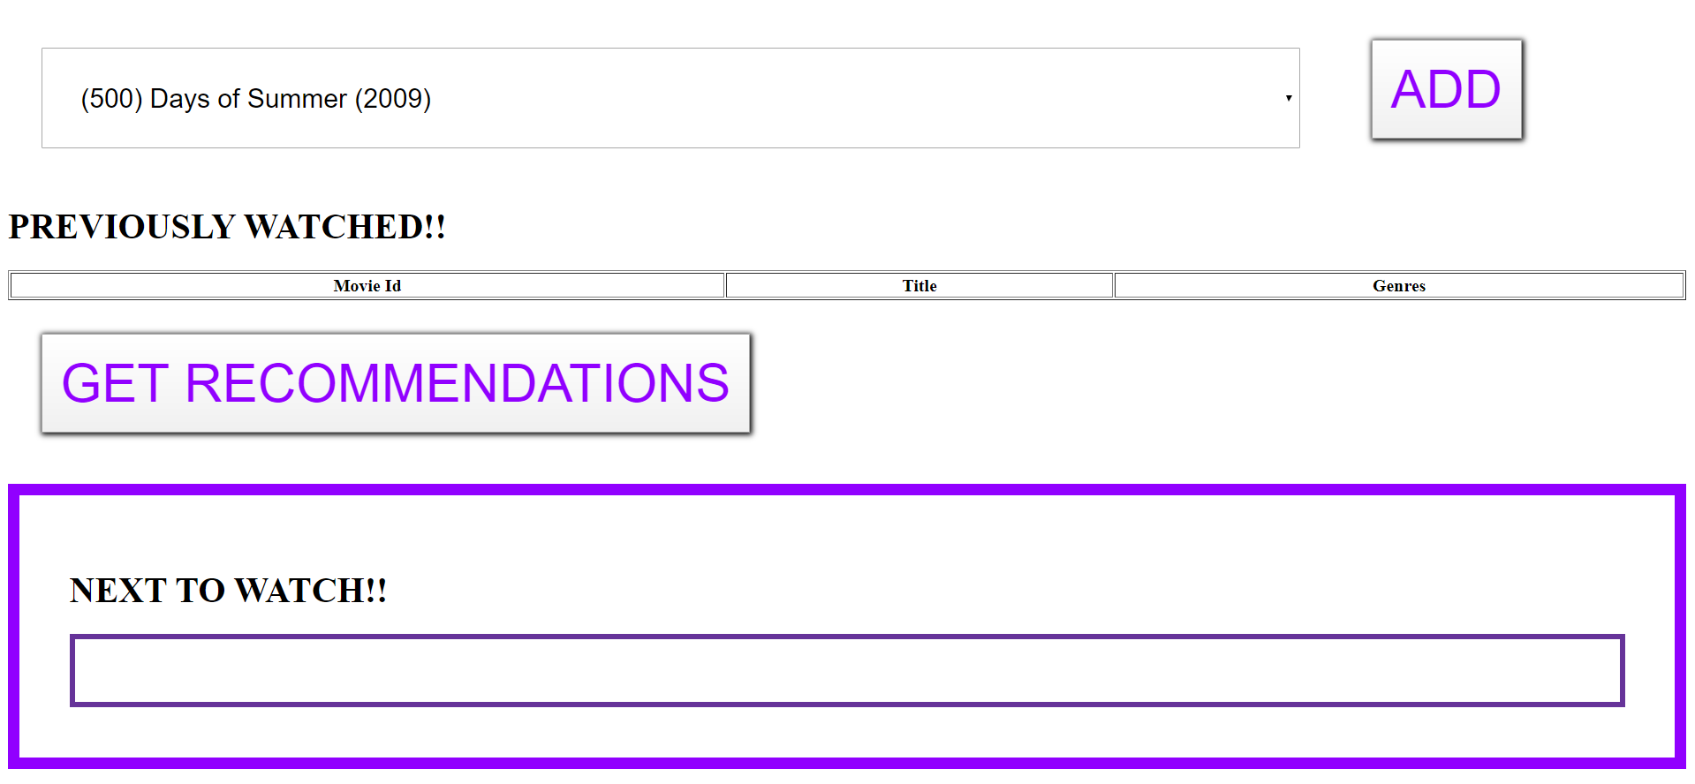
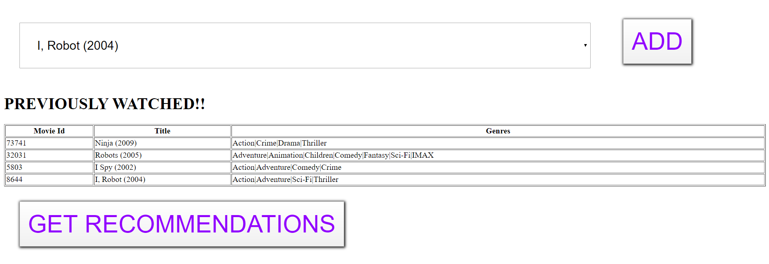

Result Screenshots of Application

Slide 13
Bibliography
1. MovieLens Datasets, https://grouplens.org/datasets/movielens/
2. K-Means Clustering, https://en.wikipedia.org/wiki/K-means_clustering
3. Navie Bayes Classification, https://en.wikipedia.org/wiki/Naive_Bayes_classifier
4. Python Flask, https://pypi.org/project/Flask/
5. Developers@Work, https://developerswork.online/
6. Wang, Z., Yub, X., Feng, N. and Wang, Z. (2014) ‘An improved collaborative movie recommendation system using computational intelligence’, Journal of Visual Languages and Computing, Vol. 25, No. 6, pp.667–675.
7. McNee, S.M., Riedl, J. and Konstan, J.A. (2006) ‘Being accurate is not enough: how accuracy metrics have hurt recommender systems’, ACM CHI ‘06 Extended Abstracts, ACM, pp.1103–1108.
8. Fields, B., Rhodes, C. and d’Inverno, M. (2010) ‘Using song social tags and topic models to describe and compare playlists’, Workshop on Music Recommendation and Discovery 2010, CEUR, September, p.633.
9. Bennett, J. and Lanning, S. (2007) ‘The netflix prize’, KDD Cup and Workshop ‘07.
10. Guy, I., Zwerdling, N., Carmel, D., Ronen, I., Uziel, E., Yogev, S.and OfekKoifman, S. (2009) ‘Personalized recommendation of social software items based on social relations’, ACM RecSys ‘09, ACM, pp.53–60.
11. Martin, F.J. (2009) ‘RecSys ‘09 industrial keynote: top 10 lessons learned deploying and operating real-world recommender systems developing’, ACM RecSys ‘09, ACM, pp.1–2.

Slide 14
Thank You

